Slide 1
Day 06
Linux Device Driver Training
GITHUB
Presented by,
Ganavi M
Ganavigowda512@gmail.com

Slide 2
GITHUB
Repository (Repo):
A repository is where your project's files and history are stored.
Command: git init (to initialize a new repository) or git clone <repository-url> (to clone an existing repository).
Commit:
A commit is a snapshot of your project at a specific point in time.
Command: git add <file> (to stage changes) followed by git commit -m "commit message" (to commit changes).
Push:
Pushing sends your committed changes to a remote repository (like GitHub).
Command: git push <remote-name> <branch-name> (usually git push origin main).
Branch:
A branch is a separate line of development, allowing you to work on different features without affecting the main codebase.
Command: git branch <branch-name> (to create a new branch) or git checkout <branch-name> (to switch to a branch).

Slide 3
Pull Request (PR):
A pull request is a request to merge changes from one branch into another (usually from a feature branch into the main branch).
Command: N/A (Pull requests are managed on GitHub's website).
Merge:
Merging combines the changes from different branches into one.
Command: git merge <branch-name> (usually done on the main branch after reviewing and accepting a pull request).
Fetch:
Fetching retrieves changes from a remote repository without merging them into your local branches.
Command: git fetch <remote-name> (usually git fetch origin).
Pull:
Pulling retrieves changes from a remote repository and merges them into your current branch.
Command: git pull <remote-name> <branch-name> (usually git pull origin main).
Clone:
Cloning creates a local copy of a remote repository on your computer.
Command: git clone <repository-url>.

Slide 4
Status:
Status shows the current state of your working directory and staging area.
Command: git status
git init: This command creates a new Git repository in your current directory. This is the first step to start tracking changes in your project.
git add: This tells Git which files you want to include in your next commit. You can add individual files or use git add -A to add all modified files.
git log: This displays a history of all the commits made in your project. You can see who made the commit, the message they provided, and the date.
git checkout: This is how you switch between different branches in your project. Branches are essentially copies of your project that allow you to work on new features or bug fixes without affecting the main codebase.

Slide 5
Discarding Changes
git clean: This removes untracked files (files not added to Git) from your working directory. Use with caution!
Branching and Merging:
git branch: Lists existing branches or creates a new branch.
git checkout -b <branch_name>: Creates a new branch and switches to it in one step.
git merge <branch_name>: Combines changes from another branch into your current branch. This can involve resolving conflicts if the same files were modified in both branches.
Remote Repositories:
git remote add <name> <url>: Adds a remote repository (like GitHub) to your local project.
git fetch: Downloads the latest changes from the remote repository without merging them into your local branch.
git pull: Fetches changes from the remote repository and merges them into your current branch (similar to git fetch followed by git merge).
git push: Uploads your local commits to the remote repository.
Additional Tips:
Use git log --graph to see a visual history of your commits and branches.
Practice on a small project to get comfortable with the commands before using Git for important work.
There are many helpful Git GUIs (graphical user interfaces) available if you prefer a visual approach

Slide 6
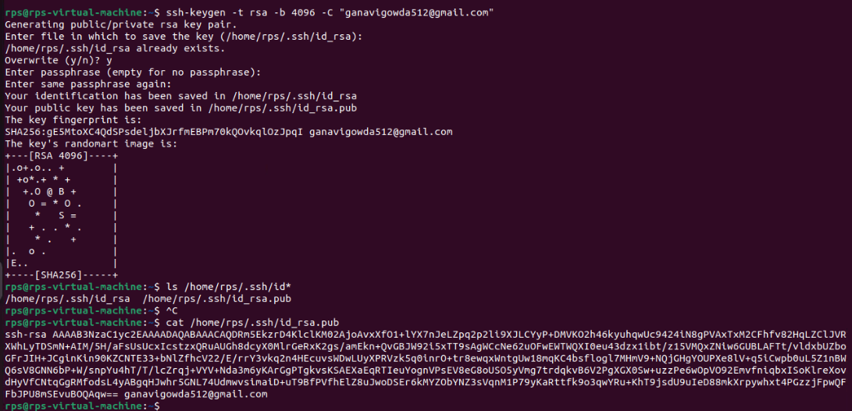
CREATING SSH KEYS
Go to terminal where the files are saved(local machine or cloud), run mentioned commands

Slide 7
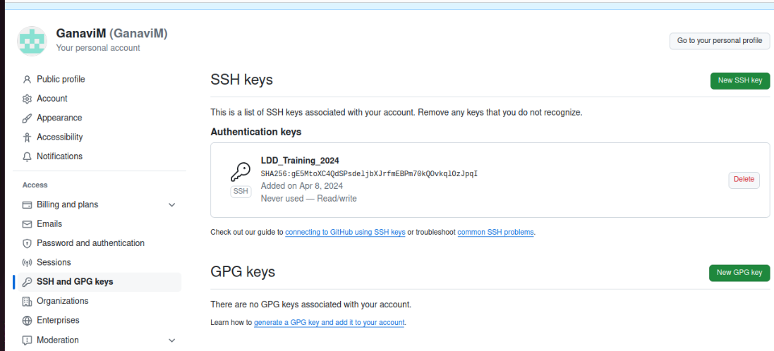
Go to your github repository and copy the link you got in the terminal, add the name u need.

Slide 8
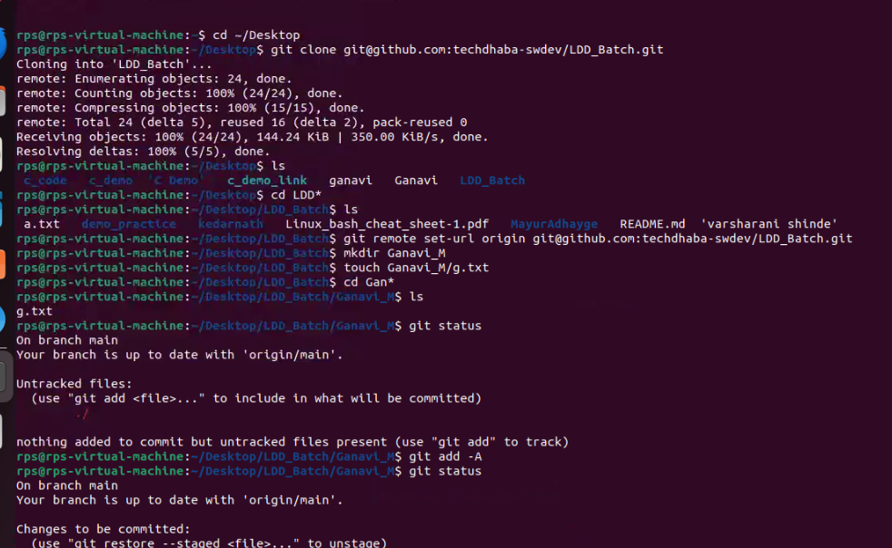
Pushing Files into GitHub using Git Command

Slide 9
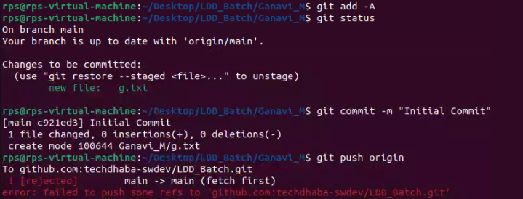
Committed the changes but didn't get pushed.. Follow the below commands for pushing the file

Slide 10
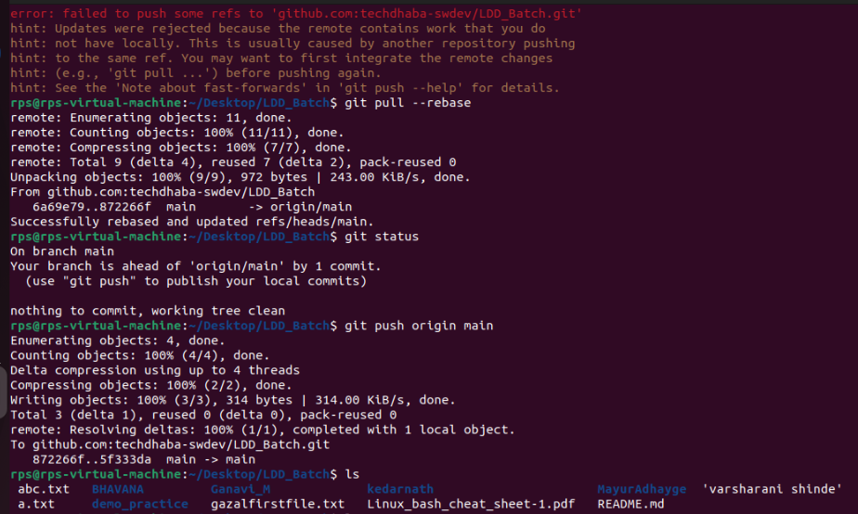

Slide 11
Thank you

